Slide 1
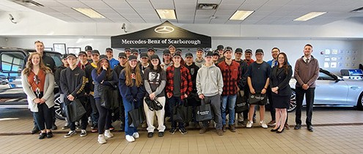
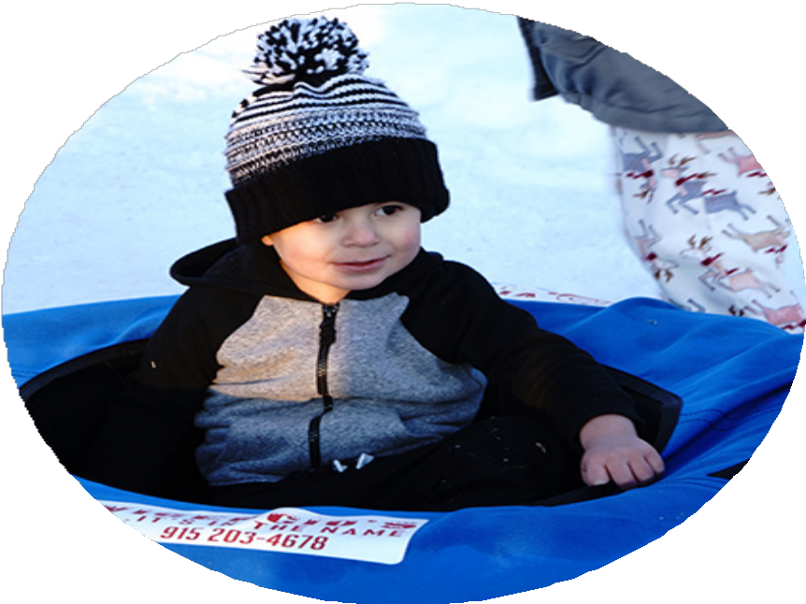
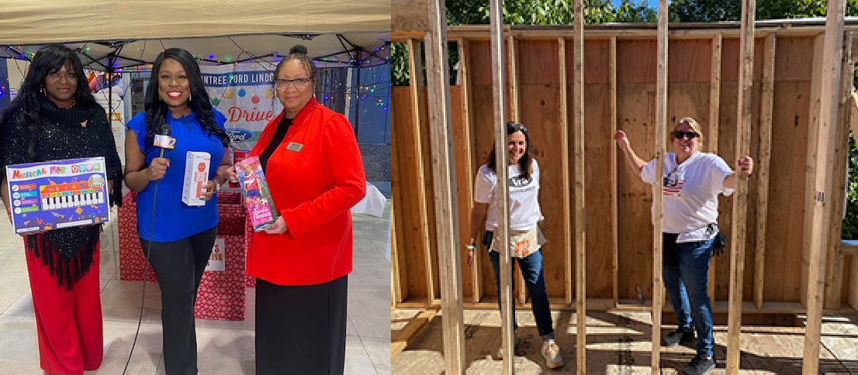
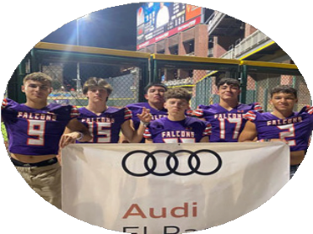
2022 COMMUNITY IM PACT

Slide 2
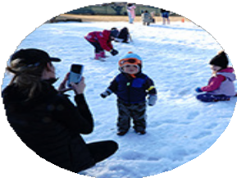
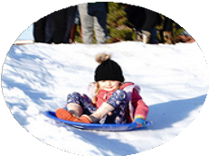
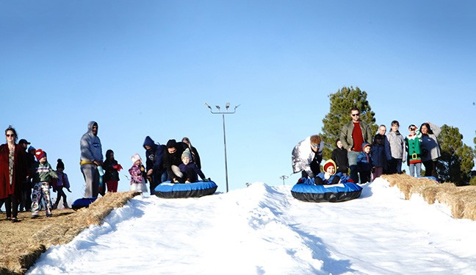
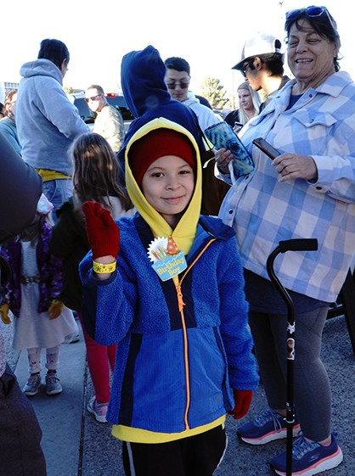
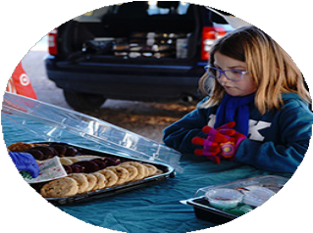
Honoring First Responders and Veterans
Finding Bliss at Fort Bliss
Shamaley Ford supported the Free Snow Day at Fort Bliss MWR (Morale, Welfare, and Recreation) Community with U.S. Army soldiers and their families. The dealership also helped with the 1st Annual Veterans’ Support Car Show, held at the dealership, benefiting the El Paso Veterans & Riders Association.
“Shamaley Ford supports MWR in so many ways and we have built a great, ongoing relationship.”
— Bill Ketcherside, Director, Fort Bliss MWR

Slide 3
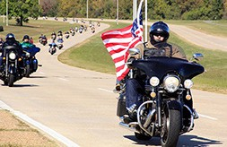
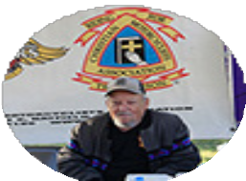
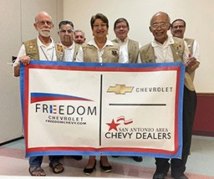
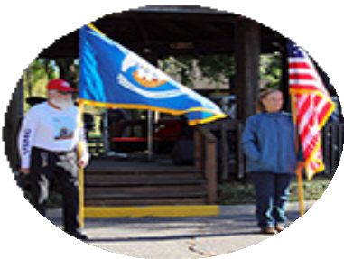
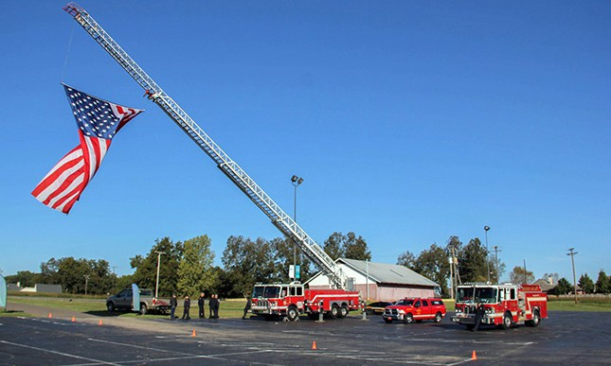
An Honor and a Privilege
Freedom Chevrolet donated $2,500 to Wreaths Across America, a nationwide program providing wreaths for our military veterans at our national cemeteries. The St. Pius Chapter of Veterans for Christ raises money for this program.
Miles for the Military
Rountree Ford Lincoln began an annual show of support for the Vets for Vets Warrior Run. The event included a 5K race, Fun Run and Bike & Car Show. The dealership donated
$1,000 and attended the event. The proceeds help and honor our military veterans.
Toys from Toyota
Rivertown Toyota participated in a local toy drive benefiting veteran and active-duty service members and military families in the area. The dealership sponsored a veteran family, worked to secure additional sponsors and served as a drop-off location point for donated toys.

Slide 4
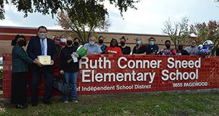
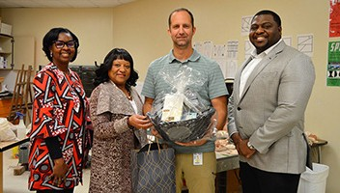
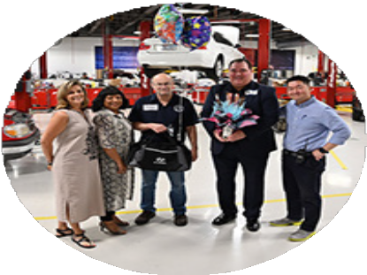
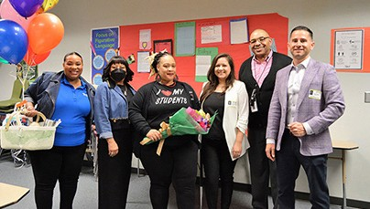
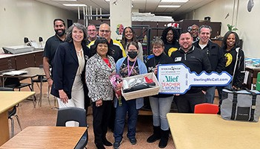
Supporting Education + Workforce Development
“Spring Branch ISD is so grateful for Group 1’s support of our amazing educators through the Teachers Driving Success program. We thank you for your collaboration, generosity and continued partnership.”
— Abigail Walker
Director of Community Engagement
Spotlighting Our Texas Teachers
In 2022, we recognized teachers across Texas for driving success in and out of the classroom. These teachers were honored for their passion for teaching and dedication to making an impact on the lives of their students each and every day. Group 1 Automotive is proud to support the efforts of the wonderful teachers we have in Houston, Alief, Spring Branch and Lubbock.
Alief Independent School District
Group 1 Automotive, Sterling McCall Acura, Sterling McCall Buick GMC, Sterling McCall Honda, and Sterling McCall Collision Center support the Teacher of the Month program at Alief Independent School District. Teachers are chosen each month to receive a personalized gift basket, gift card and flowers!

Slide 5
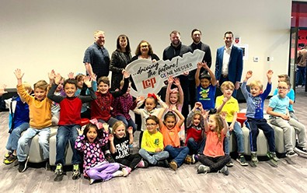
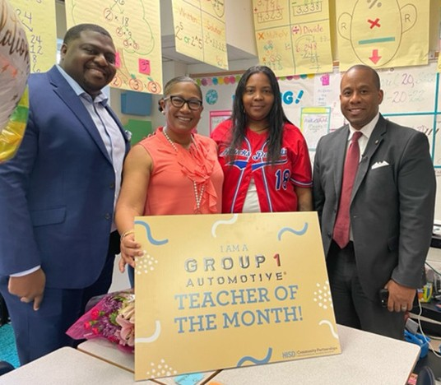
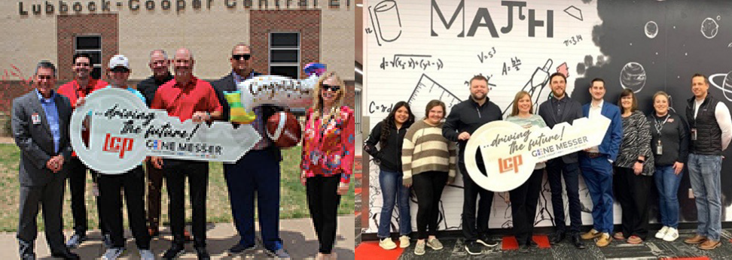
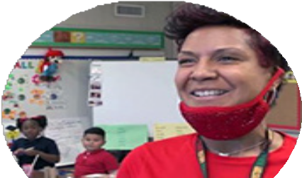
Houston Independent School District
Group 1 Automotive, Sterling McCall Chevrolet, Sterling McCall Ford, and Sterling McCall Honda support the Teacher of the Month program at Houston Independent School District. The honored teachers were surprised in their classrooms with gifts and awards.
Lubbock-Cooper Independent School District
Gene Messer Auto Group supports the Teacher of the Month program at Lubbock-Cooper Independent School District. The honored teachers were gifted with $1,000 each and Driving the Future awards for their positive impact on their students.

Slide 6
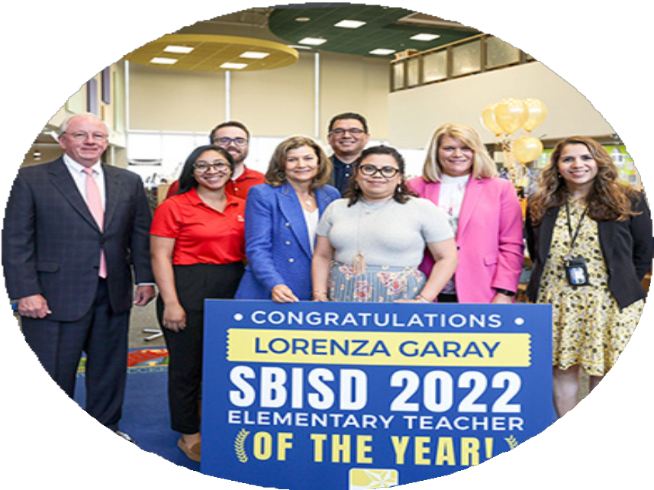
Spring Branch Independent School District
Group 1 Automotive, Advantage BMW Midtown, Sterling McCall Lexus, and Sterling McCall Toyota support the Teacher of the Month program at Spring Branch Independent School District. The honored teachers were surprised with balloons and flowers, gift baskets and a gift card.
At the conclusion of each school year, the program presents an award to two teachers designated as Teacher of the Year. The 2022 Elementary Teacher of the Year winner was Lorenza Garay from Ridgecrest Elementary. The Secondary Teacher of the Year winner was Stratford High School’s Sara Russo. Both winners were surprised by Superintendent Dr. Jennifer Blaine, as well as program sponsors Group 1 Automotive, Sterling McCall Auto Group and First Community Credit Union.
Gift Baskets and Gift Cards

Slide 7
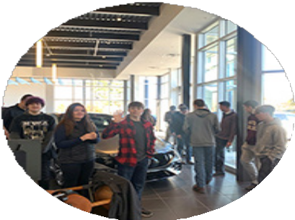
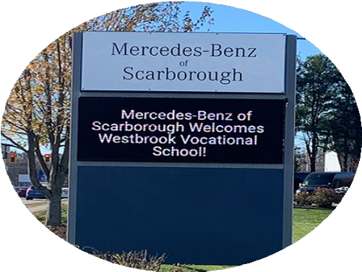
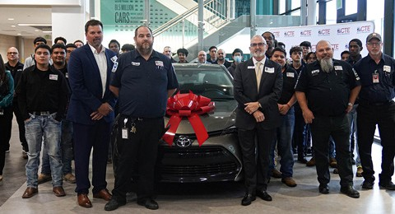
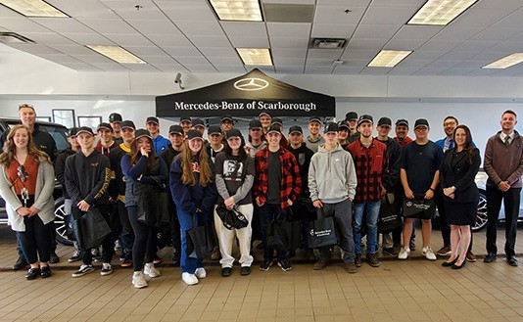
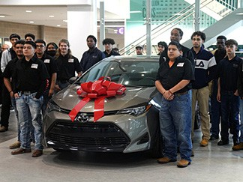
Career Readiness
Mercedes-Benz of Scarborough hosted an in-dealership technician Job Shadow Day for Westbrook Vocational School, showcasing the day-to-day work the students could accomplish when choosing this career path.
Sterling McCall Toyota Fort Bend partnered with local Toyota dealers to donate a 2022
Toyota Corolla to Fort Bend Independent School District. The car will be used as a learning tool for automotive students, providing hands-on experience in vehicle servicing.

Slide 8
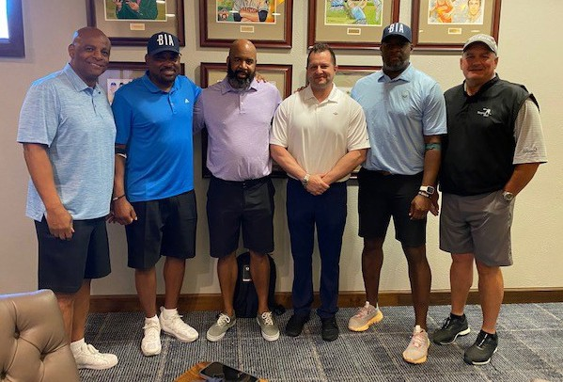
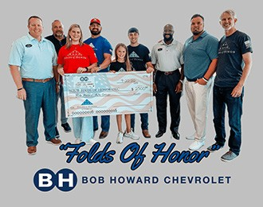
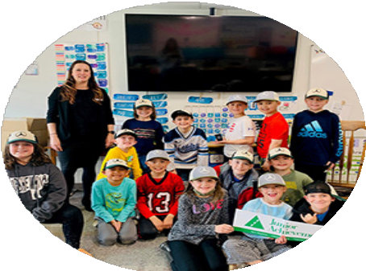
Support from Kindergarten to Senior Year
Bob Howard Auto Group raised money to support the education of five students as part of Folds of Honor. Recipients of this $500 scholarship are family members of fallen or disabled military and first responders.
Brothers in Arms was formed under the leadership of three legendary Houston quarterbacks — Andre Ware, Warren Moon, and Vince Young — who were all raised by single mothers that emphasized
the importance of education. The nonprofit, in partnership with Houston Sports Association, offers financial assistance and diversity scholarships to student athletes who are also being raised in a single parent environment. Group 1 Automotive supported the 2nd annual
golf tournament fundraiser and competed as a team during the Insperity Invitational tournament week in The Woodlands.
Mercedes-Benz of Scarborough supports Junior Achievement by volunteering multiple times a year in area classrooms and donating to the organization’s annual fundraising gala.

Slide 9
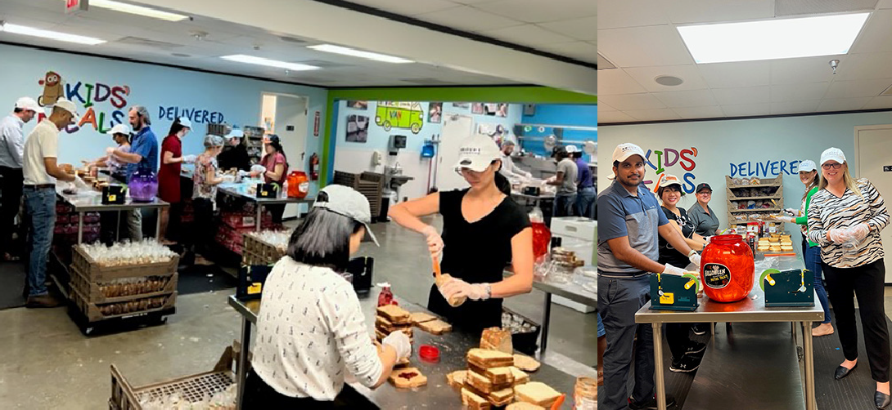
Group 1 Automotive Cares in the Community
Group 1 Automotive takes an active role within its communities and dedicates hundreds of hours to giving back and supporting its neighbors. For years, Group 1 Automotive has prioritized supporting local organizations and nonprofits dedicated to improving the communities in which we live and work.

Slide 10
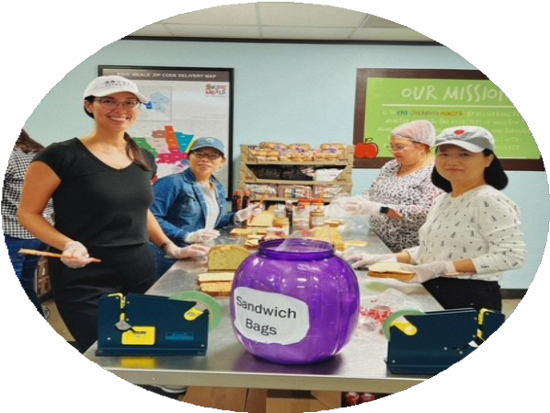
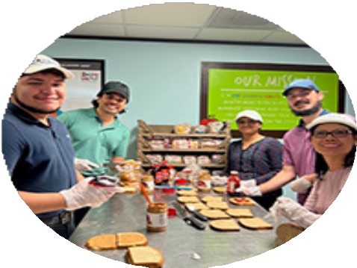
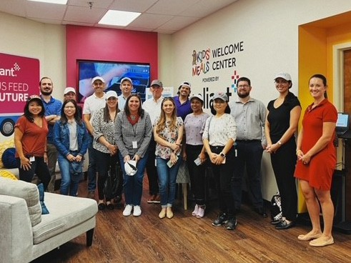
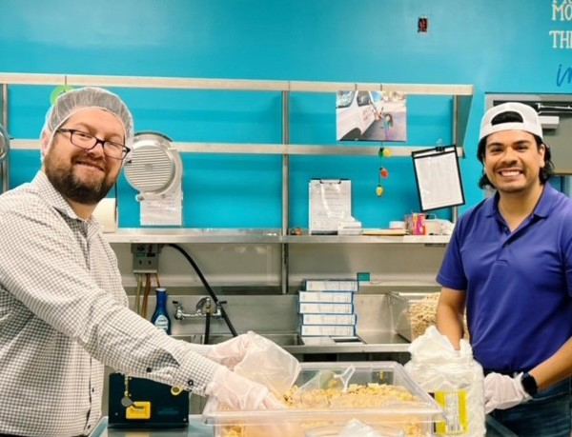
Building Hope with Kids’ Meals
The company is a longtime supporter of Kids’ Meals, which provides free, healthy meals directly to the homes of hungry preschool-aged children in need. Group 1 Automotive provides support in time, money and in-kind donations to help their mission. In just a five-month span in 2022, Group 1 Automotive employee volunteers contributed nearly 200
hours of time to making sandwiches and snacks and packing lunches.
Group 1 Automotive committed over $35,000 toward the nonprofit as well, from contributing to a new meal distribution van, supporting the annual Harvest Luncheon and golf tournament fundraisers, in addition to the Adopt-A-Family Christmas Holiday Hope program.
Group 1 Automotive supported the Christmas program by adopting
25 families to provide Christmas gifts for over 200 people. Each family member received 4–6 gifts (approximately 1,000 gifts), and every family received a $125 grocery gift card. The Adopt-A-Family endeavor includes employees raising funds, purchasing and wrapping gifts, and organizing and delivering carloads of presents to every family. The company matched employee fundraising to put the star on top of the generous holiday spirit.
“Group 1’s ongoing commitment to supporting Kids’ Meals has made a tangible impact on the lives of the preschool-aged children and families we serve.”
– Beth Harp, CEO

Slide 11
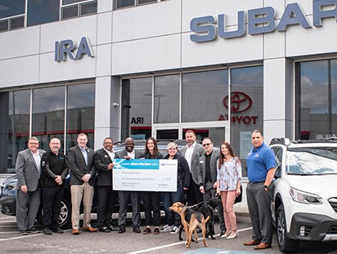
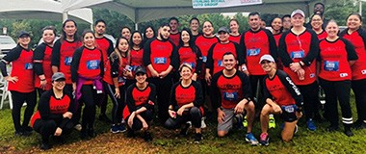
Rallying Together
On March 20, Subaru El Paso held a rally for employees, their families
and customers. With donations from Subaru of America and Group 1 Automotive, the dealership was happy to present a $30,000 check to El Paso Center for Diabetes Association.
Ira Subaru Share the Love Event
On April 27, Ira Subaru presented The Northeast Animal Shelter in Salem, MA with a donation of $33,451 as part of Subaru’s Share the Love campaign to assist with the shelter’s local efforts. This donation was made possible by a joint effort from Ira Subaru employees, Subaru of America and Subaru of New England. Ira Subaru Management Team, including General Manager, Roscoe Robinson; Ira Motor Group Market Director, Jon Zillioux; Subaru of New England Management and guests participated in this event.
Running for a Cause
Employees from the Group 1 Automotive corporate office and Sterling McCall Auto Group participated in the Hess Houston Corporate Run 5K. This charitable event promotes corporate wellness and employee team building in Houston. All levels of runners and walkers are encouraged to participate. Proceeds benefit Memorial Park Conservancy, which is
committed to restoring, preserving and enhancing Memorial Park for the enjoyment of all Houstonians. In 2022, the Group 1 corporate office and Sterling McCall Auto Group had approximately 30 team members come out and run for this charitable cause.

Slide 12
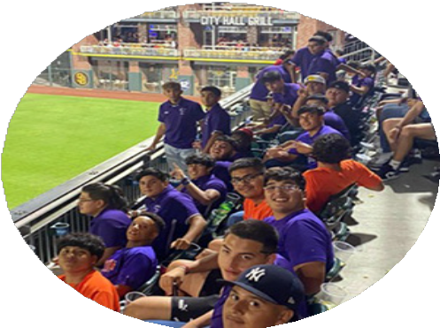
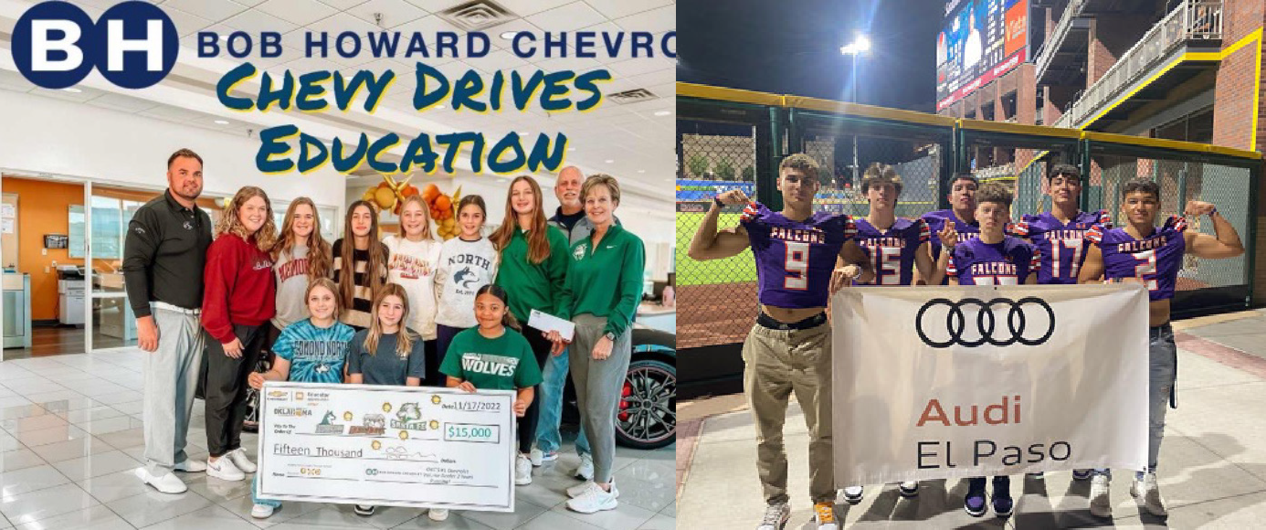
Go, Team! Supporting Area Athletics
Bob Howard Chevrolet donated $15,000 to support youth softball and promote teamwork, sacrifice, discipline, work ethic and camaraderie. The donation was divided among the three schools: Edmond North, Edmond Memorial and Edmond Santa Fe.
Audi El Paso had a great night with the Eastlake High School Football program enjoying the El Paso
Chihuahuas game and recognizing the team and their teachers for a successful season.

Slide 13
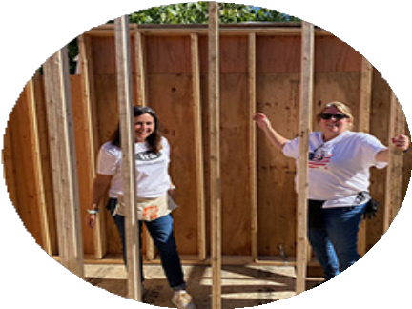
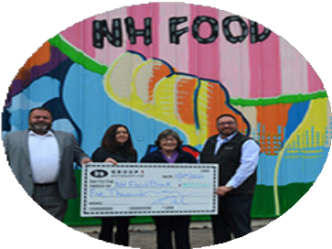
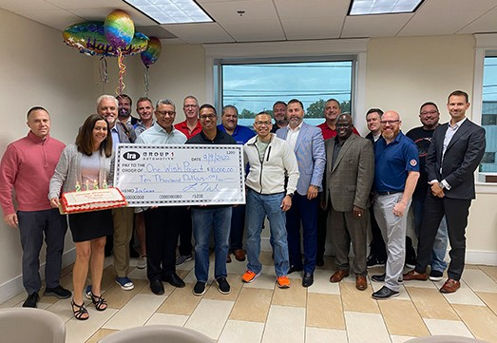
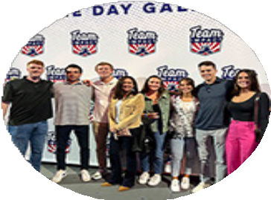
Teammates in Action
Coming Together for the Community
Ira Motor Group supports a number of organizations across Massachusetts, New Hampshire, New York, New Jersey and Maine. For example, the dealerships donated $12,500 to the One Wish Project — a local organization that makes
birthdays sweeter for children in homeless shelters and foster care with birthday cakes and presents. The group donated
$10,000 to Build-A-Bed, an organization that provides beds and linens, served
as a distribution center during the Cape Toy Drive and supported 13 charity golf tournaments in one summer.
Market Spotlight: Northeast
Supporting Communities
In late 2021, Group 1 Automotive acquired 30 dealership locations and three collision centers in the Mid-Atlantic and New England market, which are now the Ira Motor Group, under the Group 1 Automotive name. With a well-
established, family-focused culture, employees were happy to see Group 1 Automotive carry on the community support.
In 2022, from Habitat for Humanity to little leagues, and monetary donations to time-intensive support of local organizations, the Northeast market has supported children, families and adults in need.
Accelerating a Spectrum of Solutions
Autism Speaks is an organization that supports individuals with autism and their families, across the spectrum and throughout their lifespan. The organization advocates
and advances research to better the lives of those diagnosed. The Ira dealerships conducted an employee engagement campaign to support Autism Speaks and raised over $27,000 in just two weeks. The team recruited participants nationwide to reach their goal and make a difference for people.
A Winning Way to Heal
Team IMPACT is a nonprofit that helps children with serious or chronic illnesses find joy and acceptance in a safe, encouraging environment by matching them with a college athletic team for inclusion and purpose. The Ira Motor Group has partnered with Team IMPACT for seven of the ten years since the nonprofit was founded.

Slide 14
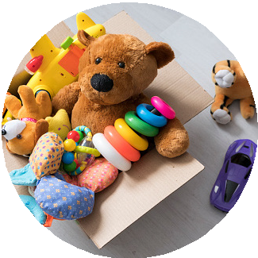
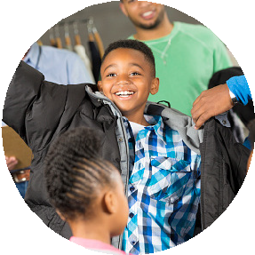
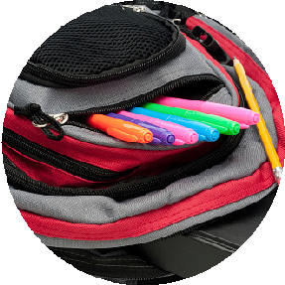
Teammates in Action
Dealership Spotlight: Rountree Ford Lincoln
Annual Toy Drive
Each year, the dealership organizes a toy drive to collect bikes, games, dolls and other toys and donates them to a local Salvation Army partner. They, in turn, distribute the toys at Christmas to families in the community who cannot afford Christmas for their children. Two years in a row,
Rountree Ford Lincoln shared about the toy drive on the local news station, KSLA, during the morning
show. The segment in December 2022 was so successful that the team doubled what was raised the previous year!
Coats & Winter Clothing Drive
Another successful dealership event is the Winter Clothing Drive, providing coats, jackets, socks and gloves to the homeless community.
This event focuses on providing coats, jackets, socks and gloves to the homeless community. Rountree Ford Lincoln
outperformed itself compared to previous years and provided a van load of items to the Hope
Connections homeless shelter.
Trunk or Treat — For the second year in a row, the dealership helped area children celebrate the spooky season by loading up a new Ford
Lightning Truck with candy to hand out at Louisiana State University in Shreveport. Of course,
while dressed to the nines in Halloween costumes!
Since Rountree Ford Lincoln General Manager Kelly McMullen stepped into his role in 2018, his major commitment has been to give back to the Shreveport-Bossier community. Kelly partners with a number of area organizations, encourages his sales and service personnel to join in and always kicks off each drive
with his own personal donation.
Annual Food Drive
Rountree Ford Lincoln hosts an annual Food Drive and partners with the local Northwest Louisiana Food Bank. In February, Rountree Ford Lincoln shared its “Peanut Butter Drive” on the local news station, KTBS First Cup morning show.
The many jars of peanut butter collected were donated to the food bank to distribute throughout the surrounding parishes. In April, the
dealership was invited to participate in the ribbon cutting ceremony for their new, larger facility.
School Supply Drive
One to two times per year, depending on the level of need in the community, the dealership hosts a school supply drive. The tenured sales staff picks a local school that has a specific need and donations are then distributed to those students. The team recently donated pallets of water to a Shreveport school in a low-income area without access to clean water, allowing students and teachers to focus on learning rather
than their safety.

Slide 15
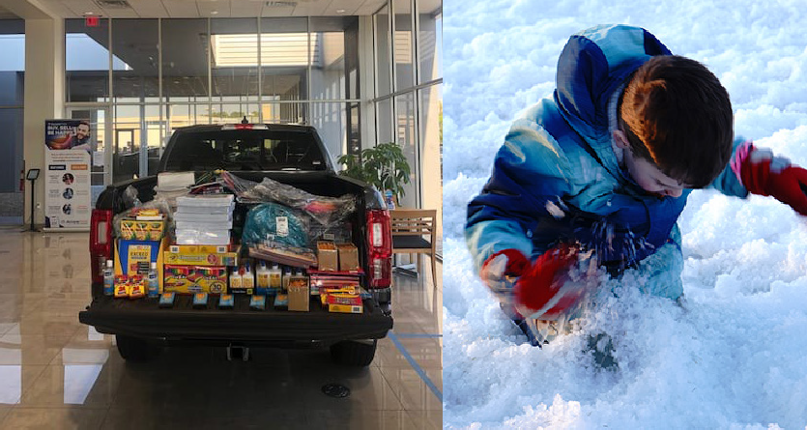
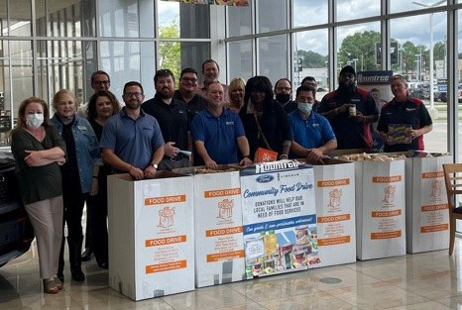
Taking an active role in the communities we serve.

